Slide 1
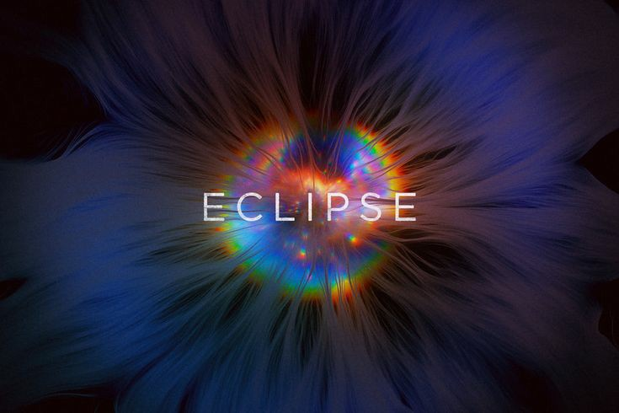
PERSPECTIVE
IS
EVERYTHING

Slide 2
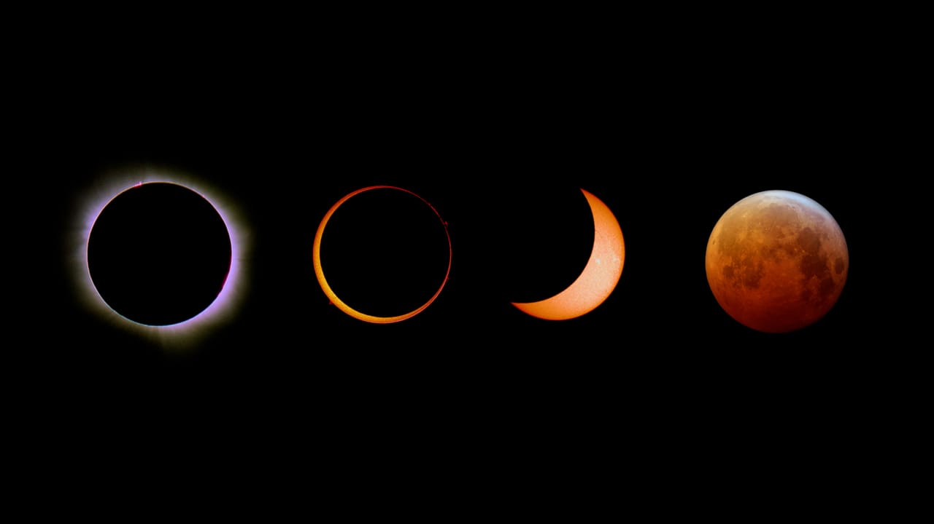
WHAT IS AN ECLIPSE ?
An eclipse occurs when one celestial body passes in front of another, blocking its light or casting a shadow. There are two main types of eclipses on Earth: solar eclipses and lunar eclipses.
Eclipses are fascinating celestial events and have cultural significance in various societies. They provide opportunities for astronomers to study the Sun, Moon, and Earth's interactions and have often been the subject of myths, legends, and scientific observation throughout history. It's important to note that observing a solar eclipse directly without proper eye protection can be dangerous and may cause eye damage

Slide 3
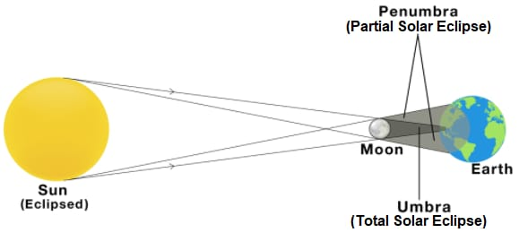
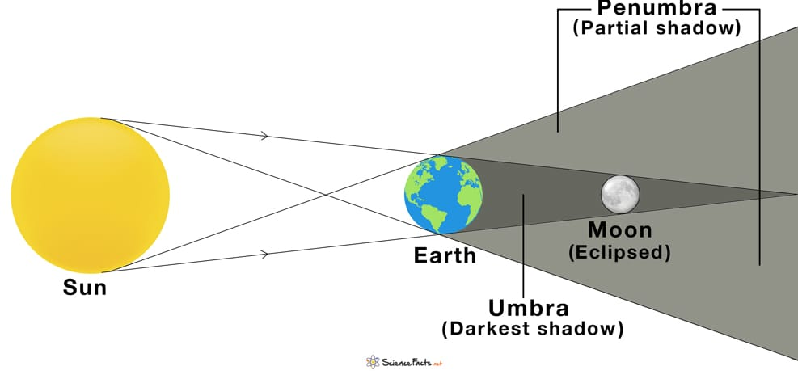
*There are two main types of eclipses on Earth ;
1. Solar Eclipse: - A solar eclipse happens when the Moon passes between the Earth and the Sun, blocking all or part of the Sun's light.
2. Lunar Eclipse: - A lunar eclipse occurs when the Earth passes between the Sun and the Moon, casting its shadow on the Moon.

Slide 4
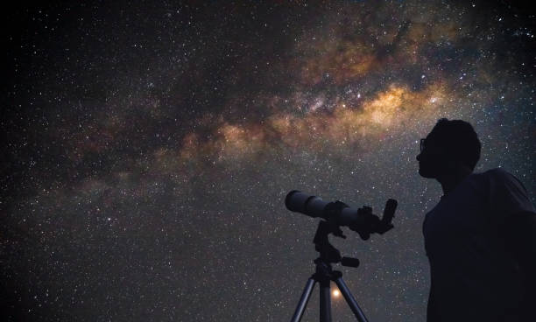
Why do only some people on Earth see an eclipse?
*During a solar or lunar eclipse, only some people on Earth see it at a given time because eclipse
are caused by the alignment of the Earth, the Moon, and the Sun.
Solar Eclipse : A solar eclipse occurs when the Moon passes between the Earth and the Sun, blocking the Sun's light. This creates a shadow on Earth, and only the regions within this shadow can witness the eclipse. The rest of the world does not see it because the Moon is not blocking the Sun from their perspective.
Lunar Eclipse : A lunar eclipse happens when the Earth comes between the Sun and the Moon, casting its shadow on the Moon's surface. People on the nighttime side of the Earth when this occurs can witness the lunar eclipse, but those on the daytime side cannot because the Moon is below the horizon for them.
NOTE : The specific regions that experience an eclipse at a given time depend on the positions of the Earth, Moon, and Sun in their orbits. Eclipses are relatively rare events and are only visible from certain parts of the Earth during each occurrence.

Slide 5
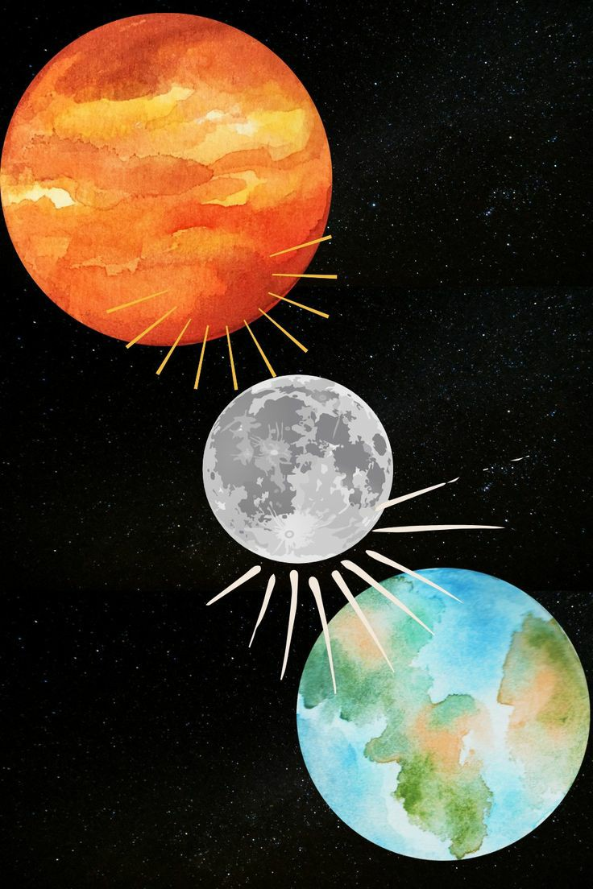
What causes the Sun, Moon, and Earth to align?
*The alignment of the Sun, Moon, and Earth can occur during specific astronomical events. One common alignment is a solar eclipse, which happens when the Moon passes directly between the Earth and the Sun, casting a shadow on Earth's surface. Another alignment is a lunar eclipse, when Earth comes between the Sun and the Moon, causing Earth's shadow to fall on the Moon.
How often do eclipses occur?
*Eclipses occur regularly but not frequently. On average, there can be up to 7 eclipses (both solar and lunar) in a year, but this number varies from year to year. Solar eclipses are less common than lunar eclipses, and the occurrence of a total solar eclipse in a specific location is even rarer.

Slide 6
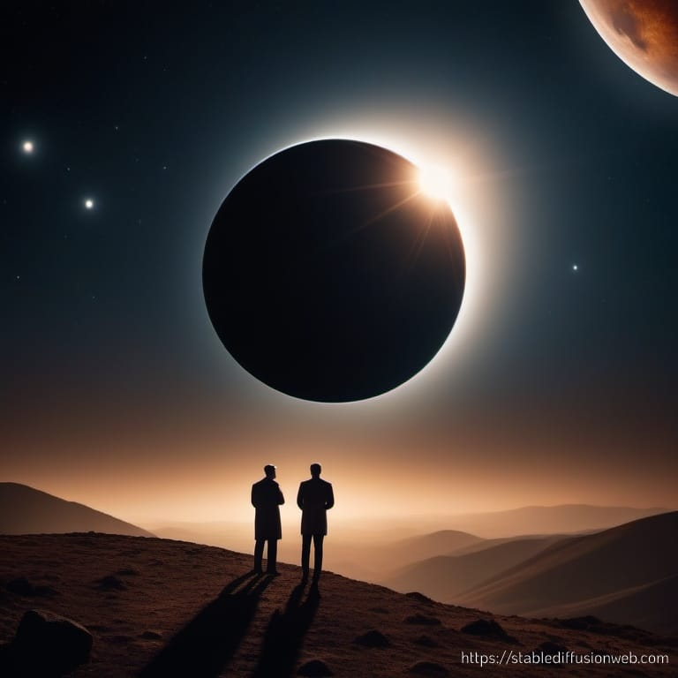
How do scientists know when and where eclipses will occur?
*Scientists can predict when and where eclipses will occur using mathematical models and astronomical data. Eclipses happen when the Earth, Moon, and Sun align in specific ways.
*Lunar Eclipse: Scientists know the Moon's orbit well and can calculate when it will pass through Earth's shadow. This produces a lunar eclipse.
*Solar Eclipse : Solar eclipses occur when the Moon passes between the Earth and the Sun, blocking the Sun's light. Since the Moon's orbit is known, scientists can predict when these alignments will happen. The path of totality, where the eclipse is total, is relatively narrow and moves across the Earth's surface.

Slide 7
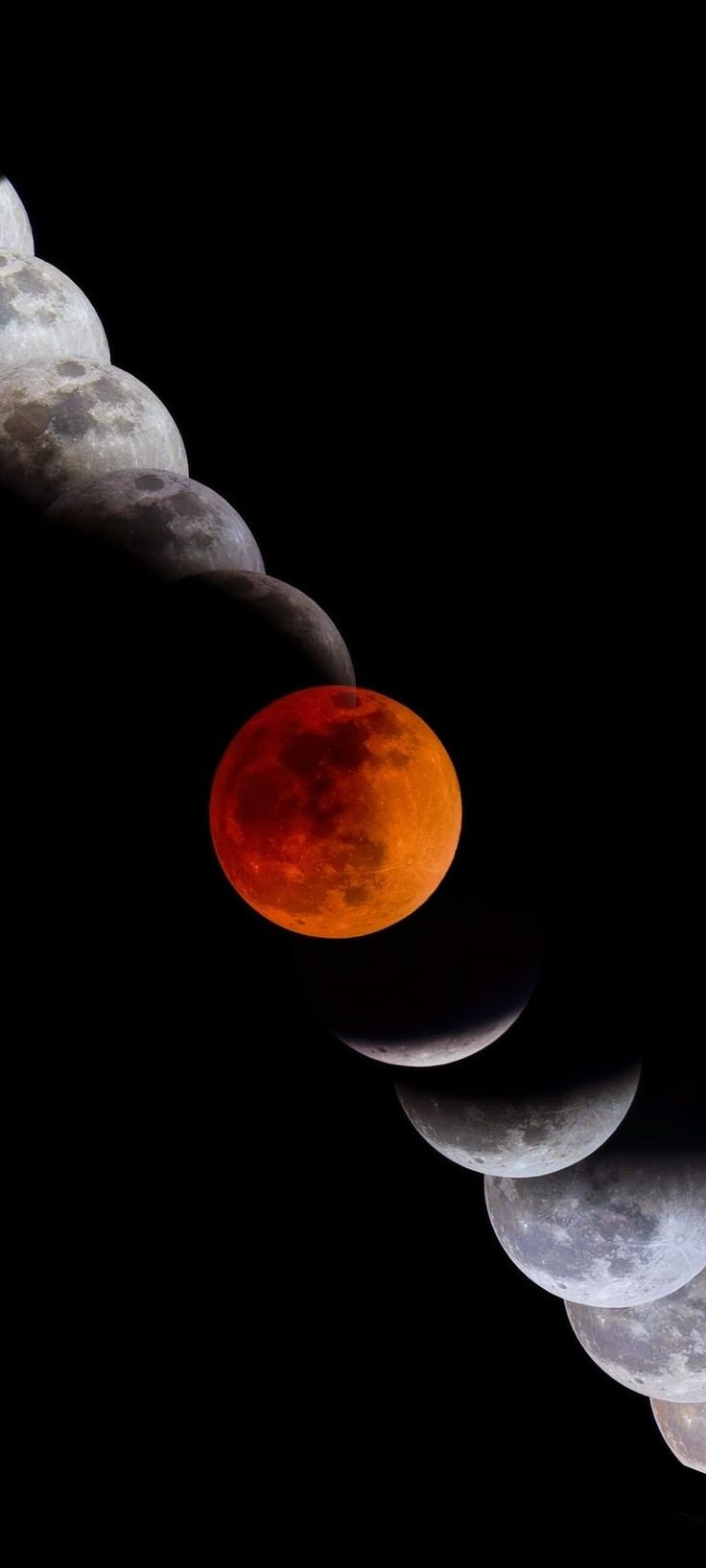
What is the difference between a lunar and solar eclipse?
*A lunar eclipse and a solar eclipse are two different celestial events that occur when the Earth, Moon, and Sun align in specific ways :
Lunar Eclipse: Occurs when the Earth comes directly between the Sun and the Moon, casting a shadow on the Moon.Requires a full moon.Earth's shadow has two parts: the penumbra (outer, lighter shadow) and the umbra (inner, darker shadow). There are three types of lunar eclipses: penumbral, partial, and total.
Solar Eclipse: Occurs when the Moon comes directly between the Sun and the Earth, blocking all or part of the Sun's light.Requires a new moon.There are three types of solar eclipses: total, partial, and annular.
.

Slide 8
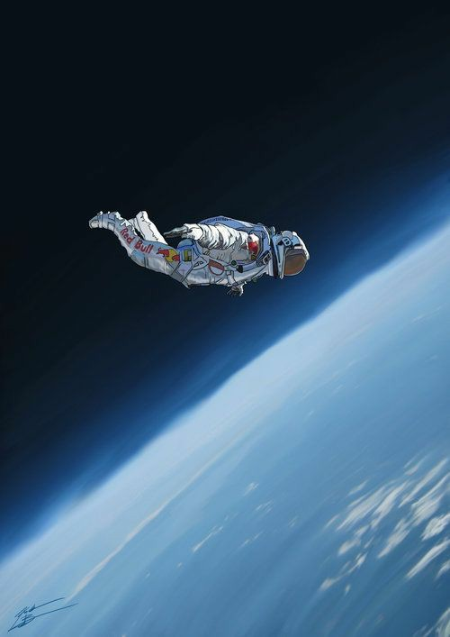
THANK YOU!

